Slide 1
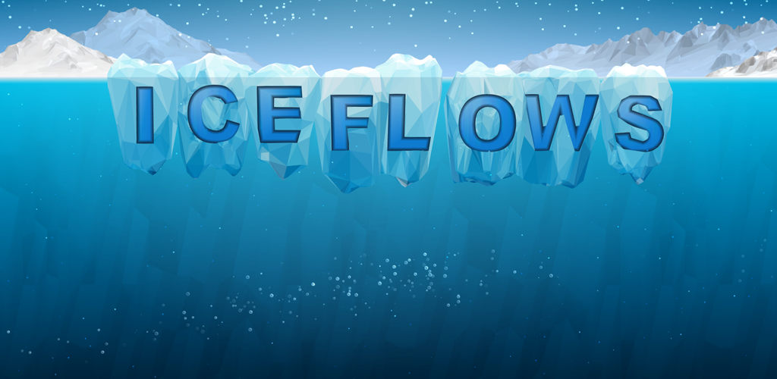

Lesson 4: Futures

Slide 2
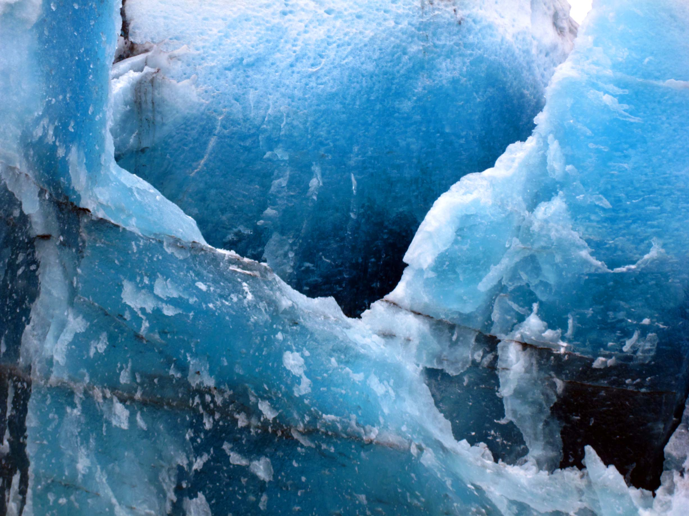
What are some of the futures for the ice?

Slide 3
Possible Futures
These are quite likely to occur, but may not…

Slide 4
Probable Futures
Of the possible options, these are the ones that are the most likely to happen

Slide 5
Preferred Futures
This is what we would like to happen ideally, as it is the best of the available options…

Slide 6

Game website http://www.iceflowsgame.com
Ice Flows Game Teacher Resource

Slide 7

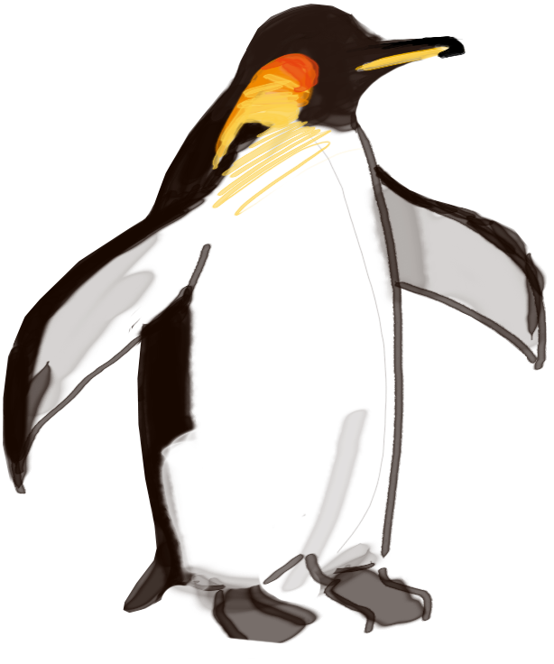
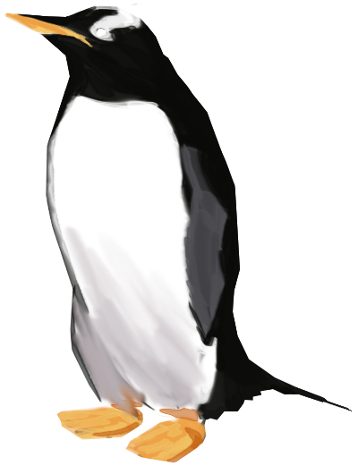
Thanks for playing!

